Slide 1
Content Management Systems
Chapter 18

Slide 2
Objectives
1
2
Content Management Systems (CMS)
Managing websites
3
4
CMS Components
WordPress Technical Overview
5
6
Customizing WordPress Templates
Modifying Themes
7
8
7
Creating a Custom Post Type
7
Writing a Plugin

Slide 3
Managing Websites
Section 1 of 8

Slide 4
Managing Websites
The most significant drawback to the sites you have created so far is that these sites require a software developer to edit the code in order to make changes
For a small company, this can be a significant problem, since they cannot afford a full-time programmer on staff.
These companies want a system that is
Easy for a nontechnical person to make changes to
Consistent and professional looking across the site
Cost effective

Slide 5
Managing Websites
Components of a Managed Website
A typical website requires :
Management provides a mechanism for uploading and managing images, documents, videos, and other assets.
Menu control manages the menus on a site and links menu items to particular pages.
Search functionality can be built into systems so that users can search the entire website.
Template management allows the structure of the site to be edited and then applied to all pages.

Slide 6
Managing Websites
Components of a Managed Website
User management permits multiple authors to work simultaneously and attribute changes to the appropriate individual. It can also restrict permissions.
Version control tracks the changes in the site over time.
Workflow defines the process of approval for publishing content.
WYSIWYG editor allows nontechnical users to create and edit HTML content and CSS styles without manipulating code.

Slide 7
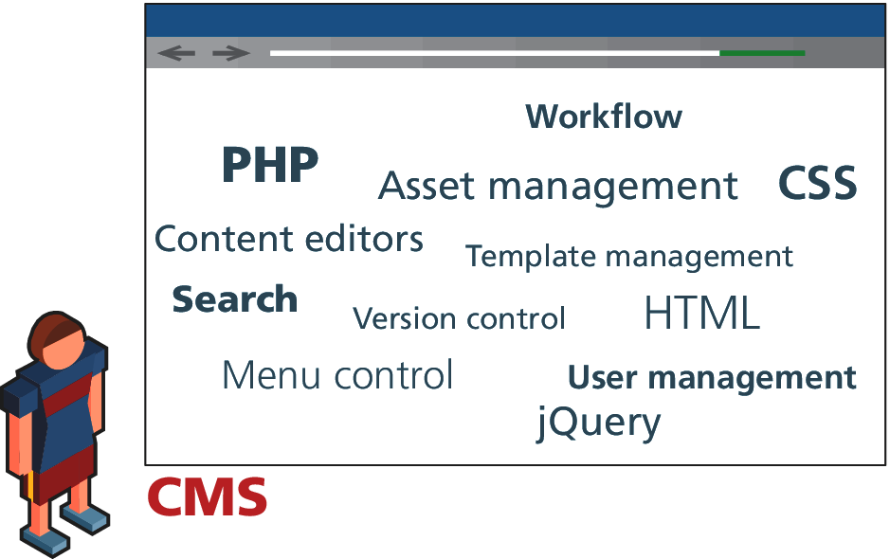
Content Management Systems
Try to make it manageable

Slide 8
Content Management Systems (CMS)
Section 2 of 8

Slide 9
Content Management Systems
Try to make it manageable
Content management system (CMS) is the name given to the category of software that easily manages websites with support for multiple users.
CMS is a Document management systems (DMSs) which has many features for documents including: file storage, multiuser workflows, versioning, searching, user management, publication, and others.

Slide 10
Types of CMS
There are a lot
A Wikipedia page of available web CMSs had 109 open-source systems and 39 proprietary systems.
These systems are implemented using a wide range of development technologies including PHP, ASP.NET, Java, Ruby, Python, and others.
Some of these systems are free, while others can cost hundreds of thousands of dollars.

Slide 11
Types of CMS
How to pick
When selecting a CMS there are several factors to consider including:
Technical requirements: the functionality it offers as well as the server software and database compatibility. Your client may have additional requirements to consider.
System support:. Since you are going to rely on the CMS to patch bugs and add new features, it’s important that the CMS community be active in supporting these types of updates or you will be at risk of attack.
Ease of use: Probably the most important consideration is that the system itself must be easy to use by nontechnical staff.

Slide 12
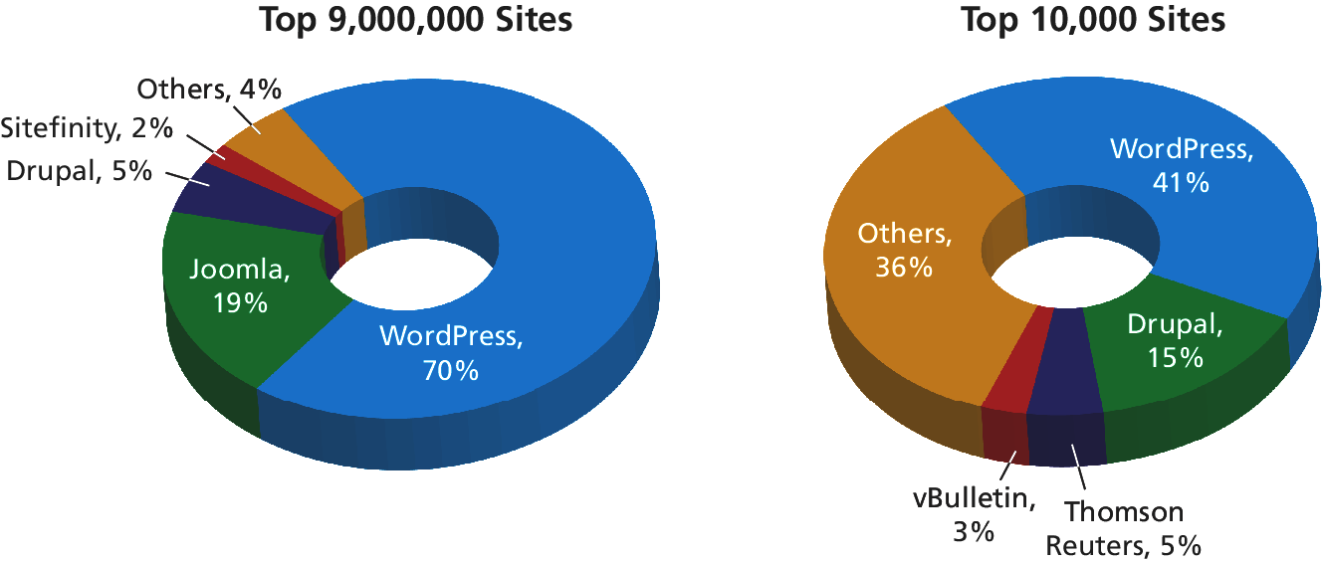
Types of CMS
We will be using WordPress

Slide 13
CMS Components
Section 3 of 8

Slide 14
CMS Components
Post and Page Management
WYSIWYG Editors
Template Management
Menu Control
User Management and Roles
User Roles
Workflow and Version Control
Asset Management
Search
Upgrades and Updates

Slide 15
CMS Components
Post and Page Management
Blogging environments such as WordPress use posts as one important way of adding content to the site.
Posts are usually displayed in reverse chronological order (i.e., most recent first) and are typically assigned to categories or tagged with keywords as a way of organizing them.
Many sites allow users to comment on posts as well.

Slide 16
CMS Components
Screenshot of a Post Editor in WordPress

Slide 17
CMS Components
What You See is What You Get
What You See Is What You Get (WYSIWYG) presents the users with an exact (or close) view of what the final product will look like.
These tools generate HTML and CSS automatically through intuitive user interfaces

Slide 18
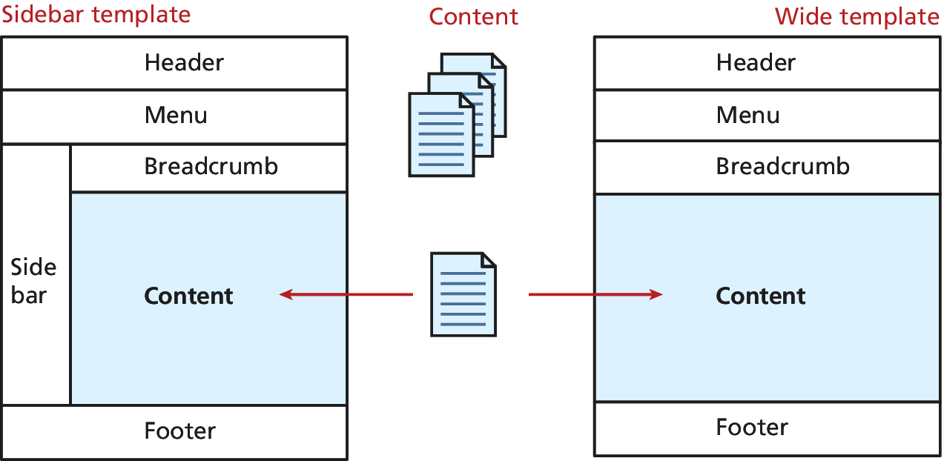
CMS Components
Template Management
Template management refers to the systems that manage the structure of a website, independently of the content of each particular page

Slide 19
CMS Components
Menu Control
Some key pieces of functionality that should be supported in the menu control include:
Rearrange menu items and their hierarchy.
Change the destination page or URL for any menu item.
Add, edit, or remove menu items.
Change the style and look/feel of the menu in one place.
Manage short URLs associated with each menu item.

Slide 20
CMS Components
User Management
User management refers to a system’s ability to have many users all working together on the same website simultaneously.
A CMS that includes user management must support:
Adding a new user
Resetting a user password
Allowing users to recover their own passwords
Allowing users to manage their own profiles, including name, avatars, and email addresses
Tracking logins

Slide 21
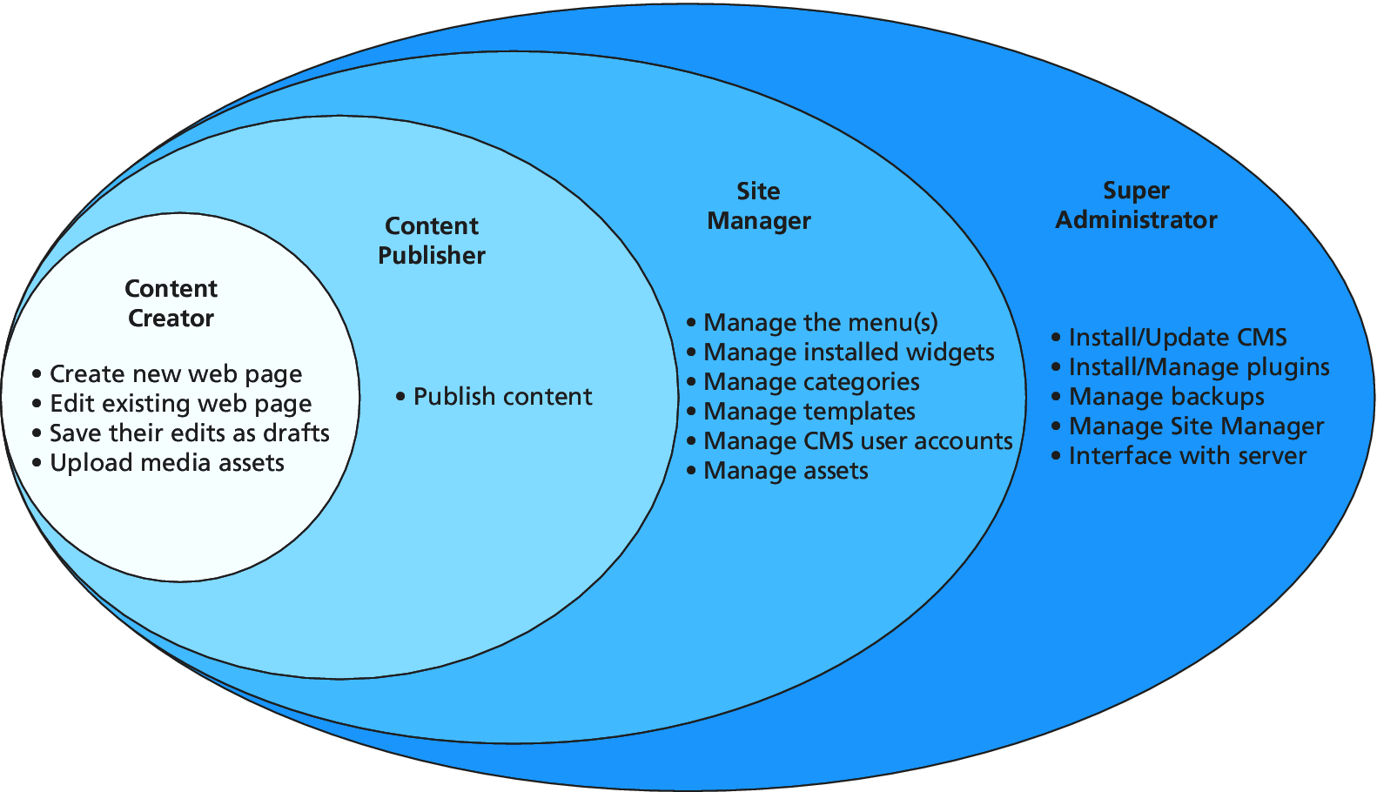
CMS Components
User Roles
Users in a CMS are given a user role, which specifies which rights and privileges that user has.

Slide 22
WordPress Roles
An implementation of Roles
In WordPress the default roles are
Administrator
Author
Editor
Contributor
Subscriber

Slide 23
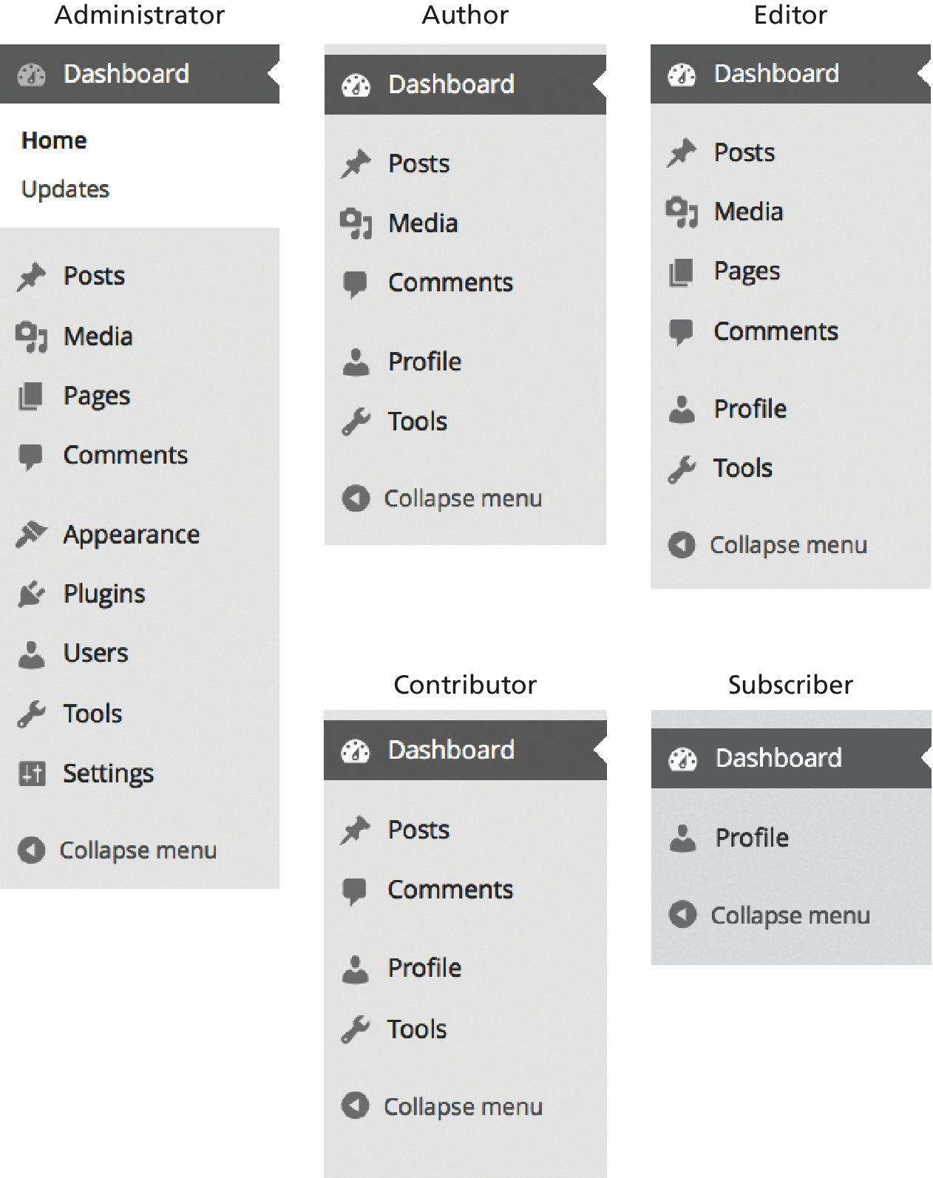
WordPress Roles
The change in dashboard options with Roles

Slide 24
CMS Components
Workflow and Version Control
Workflow refers to the process of approval for publishing content.
It is best understood by considering the way that journalists and editors work together at a newspaper.

Slide 25
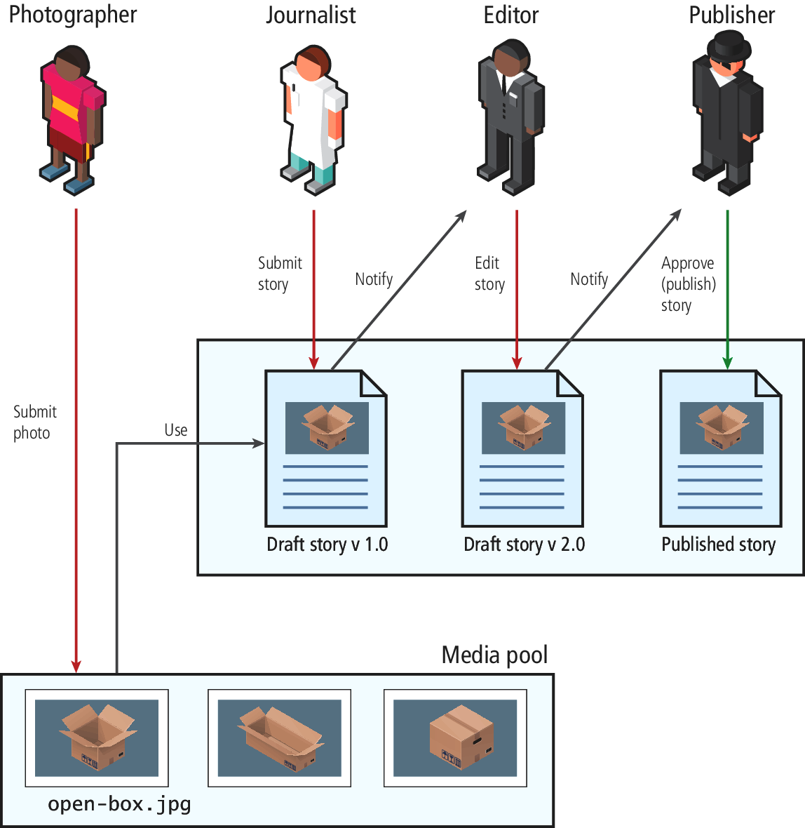
CMS Components
Workflow and Version Control

Slide 26
CMS Components
Asset Management
Asset management software enables the user to:
Import new assets
Edit the metadata associated with assets
Delete assets
Browse assets for inclusion in content
Perform searches or apply filters to find assets

Slide 27
CMS Components
Asset Management Interfaces in WordPress

Slide 28
CMS Components
Search
Searching has become a core way that users navigate websites.
There are three strategies to do website search:
SQL queries using LIKE
third-party search engines
search indexes.

Slide 29
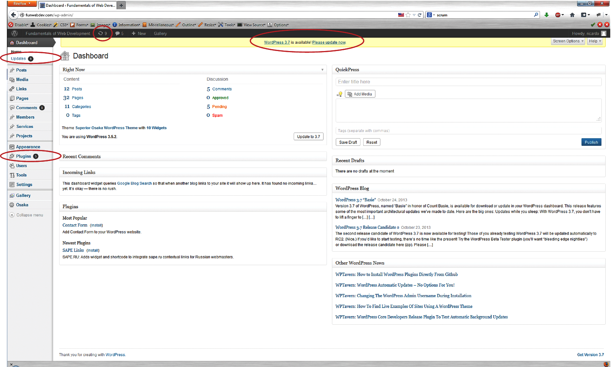
CMS Components
Upgrades and Updates

Slide 30
WordPress Technical Overview
Section 4 of 8

Slide 31
WordPress Installation
5 minute install
WordPress proudly boasts that it can be installed in five minutes! The five-minute installation has only four steps:
Download and unzip WordPress.
Create a database on your server and a MySQL user with permissions to that database.
Move the unzipped files to the location on your server you want to host from
Run the install script by visiting the URL associated with that folder in a browser and answering several questions (about the site generally and connecting to the database).

Slide 32
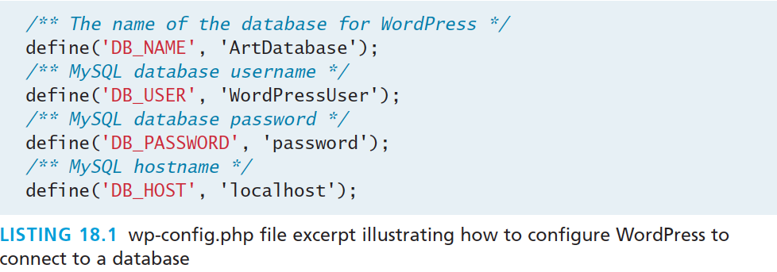
WordPress Installation
<5 minute install
The file wp-config.php allows you to set all the values asked about in the interactive installation

Slide 33
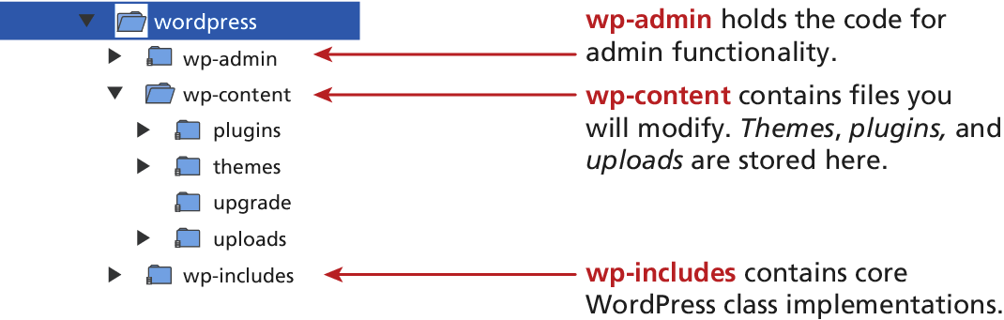
File Structure
In the end it’s all PHP code

Slide 34
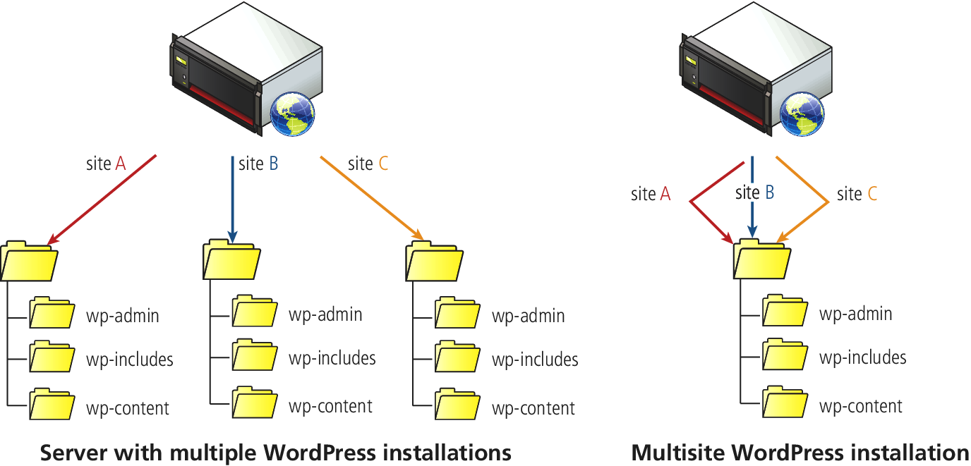
Multiple Sites on 1 Installation
Advantages for the host (sometimes)

Slide 35
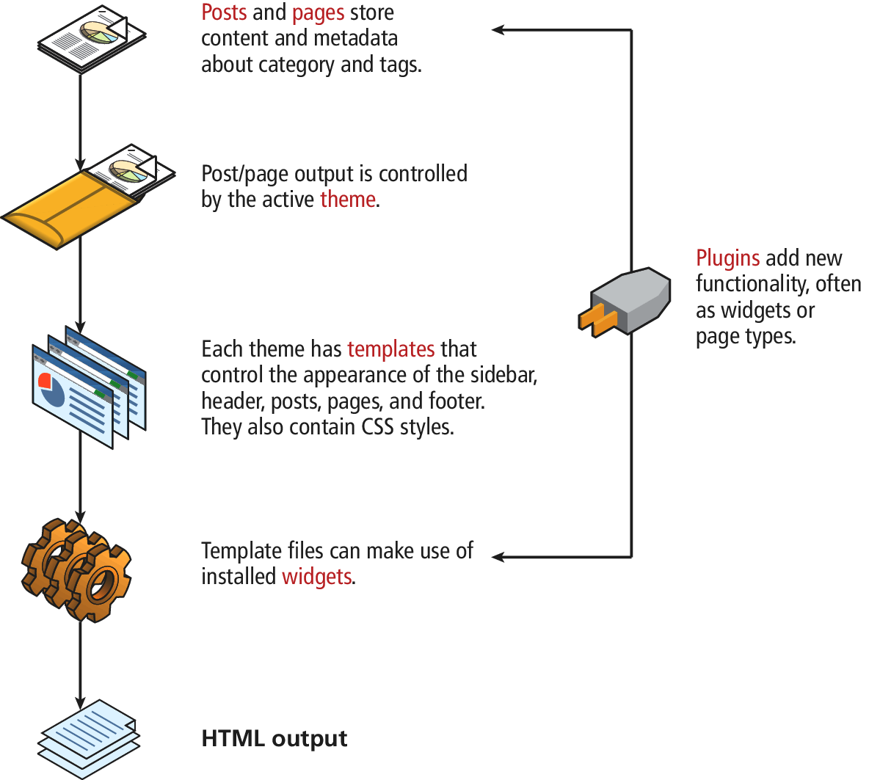
WordPress Nomenclature
A visual summary

Slide 36
WordPress Nomenclature
Posts and Pages
Posts are designed to capture a blog post, or a new update, or something else where you don’t require a menu item.
Pages in WordPress are blocks of content, which are normally associated with menu items.

Slide 37
WordPress Nomenclature
Templates and Themes
WordPress templates are the PHP files that control how content is pulled from the database and presented to the user.
WordPress themes are a collection of templates, images, styles, and other code snippets that together define the look and feel of your entire site.

Slide 38
WordPress Nomenclature
Widgets
WordPress widgets allow dynamic content to be arranged in sidebars by nontechnical users through the dashboard. Examples include:
Calendar displays a clickable calendar with links if any posts occurred this month.
Categories displays lists of links to all existing categories.
Links is a widget that allows users to manage internal or external links.
Pages displays links to all pages.
Recent Comments displays the most recent comments.
RSS displays an RSS feed.
Tag Cloud displays a clickable cloud of the top 45 words used as tag keywords.

Slide 39
WordPress Nomenclature
Plugins
Plugins refer to the third-party add-ons that extend the functionality of WordPress, many of which you can download for free.
Plugins are modularized pieces of PHP code that interact with the WordPress core to add new features.
Plugins are managed through the Plugins link on the dashboard.

Slide 40
WordPress Nomenclature
Permalinks
Permalinks is the term given to the links generated by WordPress when rendering the navigation (and other links) for the site.
Consider an unsightly URL such as the following:
Example.com/?post_type=textbook&p=396
Permalink mappings allow URLs to be rewritten in order to make them easier for the user to understand.
Example.com/textbook/fundamentals-of-web-development/

Slide 41
WordPress Nomenclature
Permalinks – Easy to SEO

Slide 42
WordPress Nomenclature
Taxonomies
WordPress supports classification of your posts with metadata related to
Authors
Categories
Tags
Link Categories
Custom Taxonomies

Slide 43
WordPress Nomenclature
Taxonomies - Categories
Categories are the most intuitive method of classifying your posts in WordPress

Slide 44
WordPress Nomenclature
Taxonomies – Other classifications
Tags are almost identical to categories except they are more open-ended, in that content creators can add them on the fly, and are not limited to the predefined terms like they are with categories.
Link categories are used internally by WordPress by those who want to categorize external links.
WordPress lets you define your own types of taxonomy

Slide 45
WordPress Template Hierarchy
Which file executes?
The default WordPress installation comes with a default theme containing many templates to support the most common types of wireframes you will need. There are templates to display:
a single page or post
the home page
404 not found page
categories of posts
an archive of posts

Slide 46
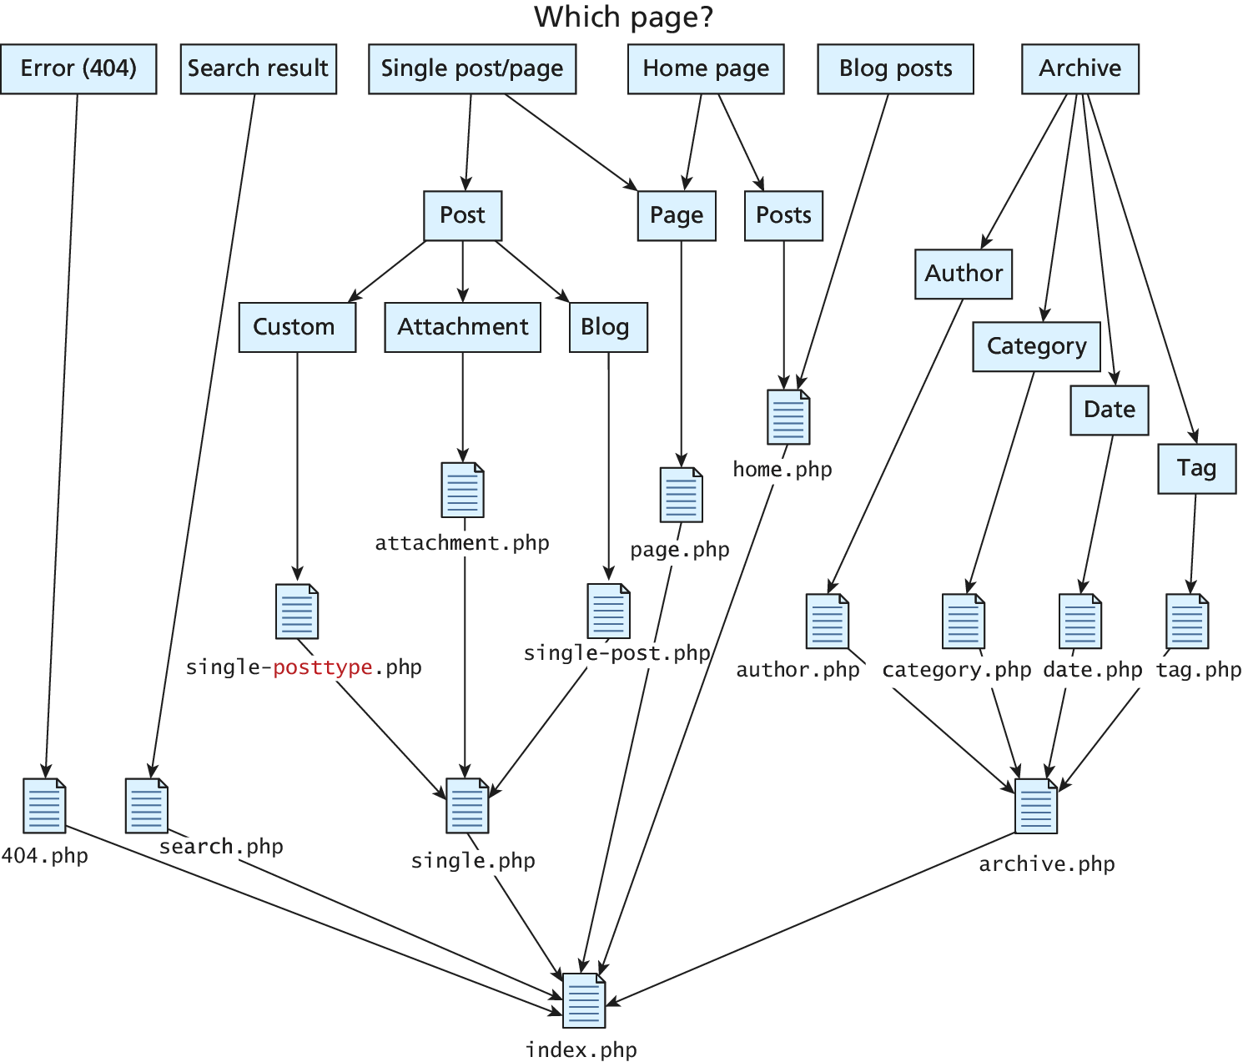
WordPress Template Hierarchy
Which file executes?

Slide 47
WordPress Template Hierarchy
Which file executes?
When a user makes a request, the WordPress CMS determines which template to use to format and deliver the content based on the attributes of the requested page.
If a particular template cannot be found, WordPress continues going down the hierarchy until it finds one, ultimately ending with index.php.

Slide 48
Modifying Themes
Section 5 of 8

Slide 49
Modifying Themes
Easy in WordPress
The easiest customization you can make to a WordPress installation is to change the theme through the dashboard
All the files you need to edit themes are found in the folder /wp-content/themes/ with a subfolder containing every theme you have installed.
Each theme contains many files found in the previously shown hierarchy

Slide 50
Changing themes
In Dashboard

Slide 51
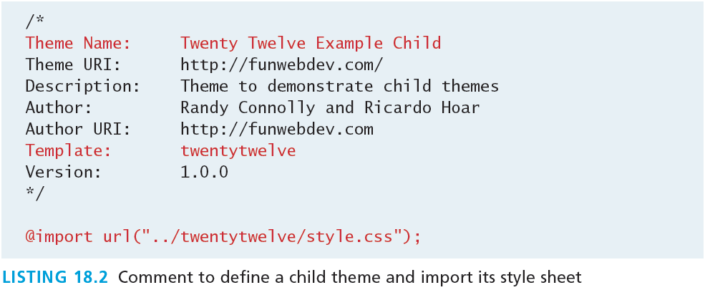
Creating a Child Theme
Once you finish you can activate though dashboard
To start a child theme from an existing one, create a new folder on the server in the theme folder.
In that folder create a style.css file with the comment from Listing 18.2, which defines the theme name and the template to use with it.

Slide 52
Creating Theme Files
You may want to change what HTML is output
determine which template file you want to change.
Copy the newly particular template file to the child theme, leaving existing page templates alone

Slide 53
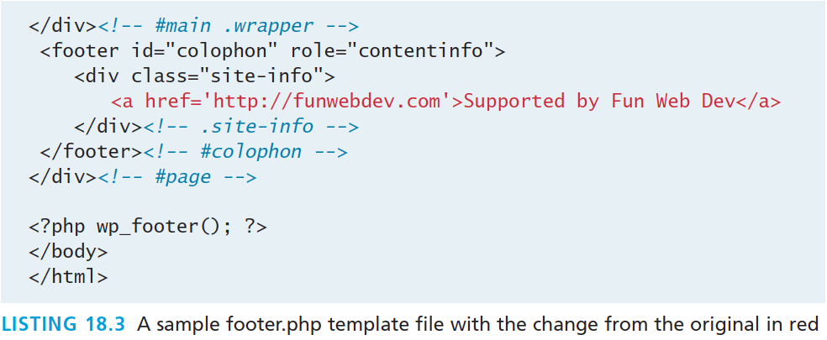
Creating Theme Files
Tinker with the footer
Many sites want to modify the footer for the site, to modify the default link to WordPress if nothing else, all of which is stored in footer.php

Slide 54
Customizing WorPress Templates
Section 6 of 8

Slide 55
Customizing Templates
Writing your own WordPress template is the easiest way to integrate your own custom functionality into WordPress
You’ve already seen how we can tinker with a template file.
Next you must understand the way WordPress works, which means learning about its core classes, the WordPress loop, template tags, and conditional tags

Slide 56
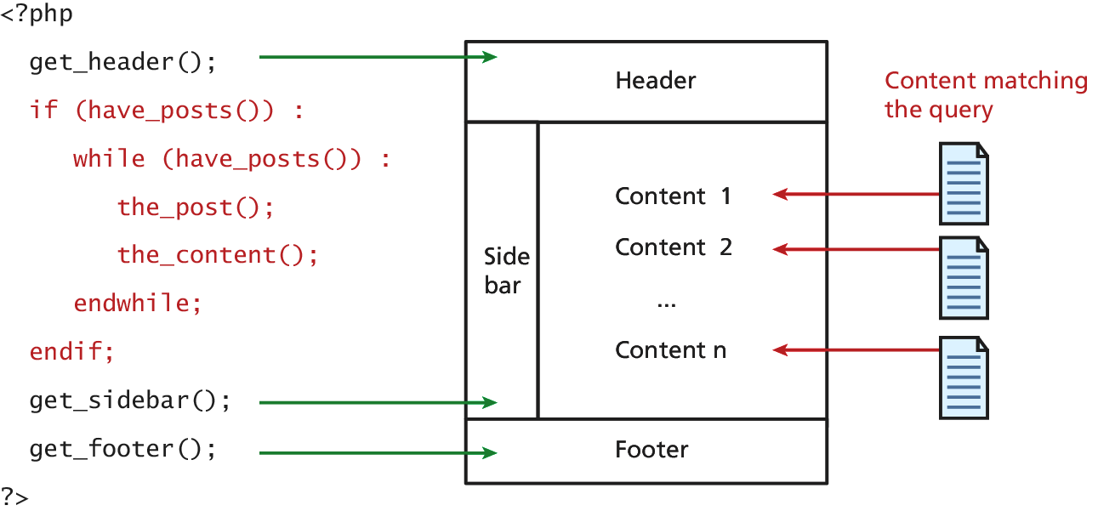
The WordPress Loop
The main loop
The WordPress loop is the term given to the portion of the WordPress framework that pulls content from the database and displays it, which might include looping through multiple posts that need to be displayed.

Slide 57
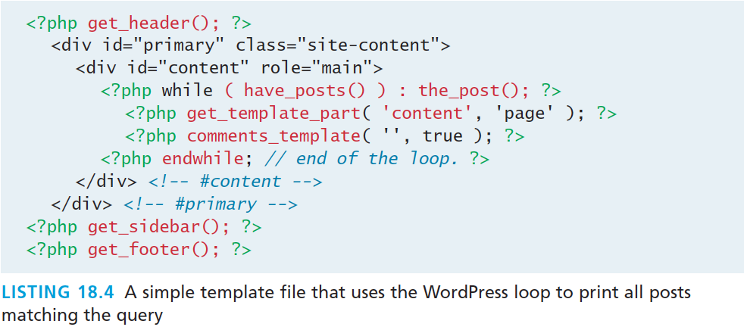
The WordPress Loop
The main loop
the template taken from the Twenty Twelve theme’s page .php template that illustrates use of the loop and common WordPress tags.
It creates a header, loops through all posts, and displays the content of each one (no title, no author, no date) and then outputs a sidebar and a footer.

Slide 58
The WordPress Loop
The main loop
Because WordPress was written in a functional way to ensure efficient operation, the loop code can be somewhat tricky to understand.
We must first understand the core WordPress classes (written in PHP) that are used in the loop.

Slide 59
Core WordPress Classes
WP_Query
WP_Query takes the URL (or post data) and parses it to build the appropriate object.
You never have to explicitly create an instance of the WP_Query object.
When you want WordPress to deviate from the default query, you can use the method query_posts() to change it and replace it entirely for use in the WordPress loop.

Slide 60
Core WordPress Classes
WP_Query
The valid keys available to be passed to the WP_Query object and query_posts() are numerous.
As you develop you should be aware that
print_r($query->query_vars);
will output all the query values that are currently present so you can easily find out if you are setting the variables properly.

Slide 61
Core WordPress Classes
WP_Query example
To select posts by author with ID 7 in category number 1,2, or 5, except those with tag 17, you would write:
$queryArray= array("author" => 7,
"cat" => array(1,2,5),
"tag_not_in" => array(17));

Slide 62
Core WordPress Classes
WP_User and the current user
In WordPress you are either serving to a logged-in user or a nonauthenticated user.
To get access to the currently logged-in user, you call
$current_user = wp_get_current_user();
This $current_user is an instance of the WP_User class. That class has many properties including ID, first_name, and last_name.
These functions include the ability to determine what capabilities a logged-in user has.

Slide 63
Core WordPress Classes
WP_User and the current user
To ask, for example, if the current user is allowed to publish a post you would write:
$cu = wp_get_current_user();
if ($cu->has_cap('publish_post',123)) {
//the current user is allowed to publish post 123.
}

Slide 64
Template Tags
For referencing elements within the loop
Template tags are really functions that can be called from inside the WordPress loop. Categories of tags are:
General Tags
Author Tags
Comment Tags
Link Tags
Page Tags

Slide 65
Template Tags
General Tags
General tags exist to give you access to global or general things about your site. Some key tags include:
get_header() includes the header.php file into your page.
get_footer(), like get_header(), includes footer.php into your site.
get_sidebar() works like the methods above, including sidebar.php

Slide 66
Template Tags
Author Tags
Since authors are WordPress users, you will be able to access all the fields that can be associated with an author, including their email, full name, visible name, and links to their detail pages on the site.
the_author_meta() can be called with two parameters, the first being the field you want to retrieve, and the second being the userID. If no second parameter is passed, the userID for the author of the current post is used.
Some commonly used fields include: display_name, user_firstname, user_lastname, user_email, and user_url. Less commonly used ones include: user_pass, ID, and description.

Slide 67
Template Tags
Comment Tags
WordPress manages comments for you and provides the following functions to allow you to programmatically access comments related to the current post.
comments_template() allows you to import a comment template into this template much like get_header(). This way all customization for how comments are displayed can be managed there.
get_comments() outputs the list of comments matching a range of options passed in.
comment_form() embeds the form to add comments into the page.

Slide 68
Template Tags
Link Tags
Although pages are just a particular type of post, they are also associated with a site hierarchy and the menu. So while they have many essential elements of posts (described later) such as title, author, and date, they also have:
get_ancestors() returns an array of the ancestor pages to the current one. They can be used to build a breadcrumb structure.
wp_page_menu() can be used to create submenus of pages.

Slide 69
Template Tags
Page Tags
Link tags are especially important for a website, since links are the basis for the WWW. Some important ones include:
the_permalink() contains the permanent URL assigned to this post. It should be wrapped inside a <A> tag if it is to be clickable.
edit_post_link() can be included if you want editors to easily be able to browse the site and click the link to edit a page. This is normally used in conjunction with conditional tags that tell us if the user is currently logged in.
get_home_url() returns the URL of the site’s home page.

Slide 70
Creating a Page Template
A new Page template
The end goal is that users in WordPress can choose to apply your new template when editing or creating a page using the dropdown interface

Slide 71
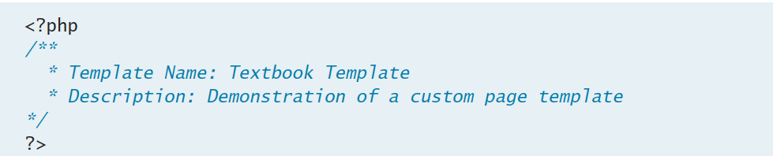
Creating a Page Template
Get Started
To get started you should create a folder named page_templates in the child theme to hold your custom page types.
Create a PHP file (ours will be textbook.php) and add a comment block to define the template name and a description as shown

Slide 72
Creating a Page Template
Post Tags
Both pages and posts have the following data available:
the_content() displays the content of the post; it can optionally display a summary with a “More” link to all content.
the_ID() returns the underlying database ID, useful elsewhere.
the_title() returns the title of the current post and optionally prints it out.
the_date() returns the time and date of the post.

Slide 73
Creating a Page Template
Category Tags
Some template tags available to you, which draw their context from the current post:
the_category() will output a list of clickable links to each category page which this post belongs to.
category_description() outputs the text description associated with the category of the post.
the_tags() outputs clickable links to tag pages for every tag used in the post.
wp_tag_cloud() outputs a word cloud using all the tags present in the site, not the post.

Slide 74
Creating a Page Template
Pagination Tags
Navigation tags in general are useful for building a well-interconnected website.
previous_post_link()/next_post_link() provide the links to the previous and next chronological posts if you wanted to have navigation forward and backward for single posts.
previous_posts_link()/next_posts_link() are pluralized forms of the above functions and allow you to get links to the previous or next set of items (say 10 per page).

Slide 75
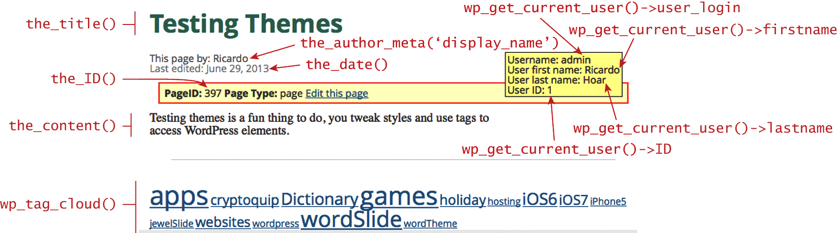
Creating a Page Template
Illustration using many tags

Slide 76
Creating a Custom Post Type
Section 7 of 8

Slide 77
Custom Post Type
What types are there already?
You can access the type of a post by using get_post_type() anywhere in the loop.
post is the default kind of content post, used for blog entries.
page is a WordPress page, that is, a page associated with a menu item hierarchy.
attachment defines a post that is an image or file attachment.
revision versioning is also stored, so you can have posts that store versioning information
nav_menu_item is reserved for menu items (which are still posts).

Slide 78
Oraganization
What types are there already?
If you were to create a new type called textbook, you would be able to surf all posts of that type by going to http://example.com/textbook/.
You could then create a file named single-textbook.php to handle a single post, and archive-textbook.php to handle displaying all the textbook posts.
A new tab will appear allowing users to easily add and manage textbook posts.

Slide 79
Registering your post type
Register with what? Where?
There is a file in WordPress named functions.php, which allows you to integrate your own post types into the framework.
To define the mere existence of the post type textbook, you would create a functions.php file in your child theme.
Unlike style.css, the functions.php of a child theme does not override its counterpart from the parent. Instead, it is loaded in addition to the parent’s functions.

Slide 80
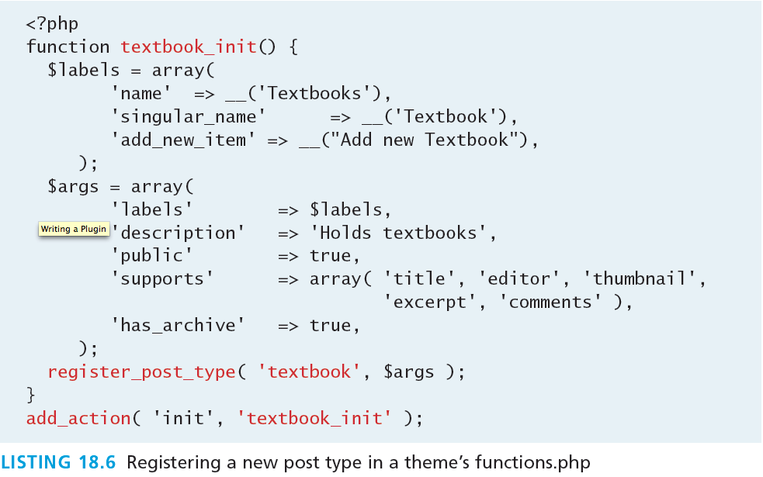
Registering your post type
Register with what? Where?

Slide 81
Adding post specific fields
Now we’re making sense.
The reason you normally create a specific type of post is that you can systematically define a new category of “item” in such a way that users can easily enter them.
In our textbook example, you might want to say that all textbook posts require details such as publisher, date of publishing, and authors.
To add those fields to the form, you must use the add_meta_box() function

Slide 82
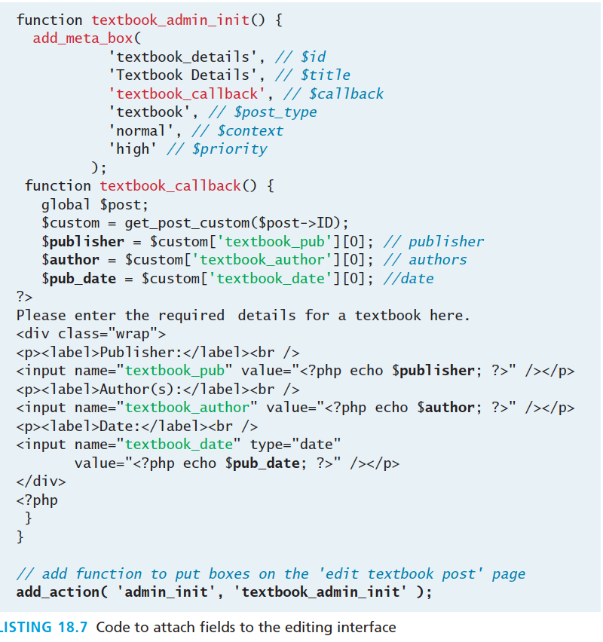
Adding post specific fields
Now we’re making sense.

Slide 83
Adding post specific fields
Now we’re making sense.

Slide 84
Under the Hood
Where do our posts go?
Two tables are used in creating custom posts. The first is the wp_posts table where things like the post date, author, title, status, and type are located.
Related directly to that is a wp_postmeta table, which is where our custom fields are stored

Slide 85
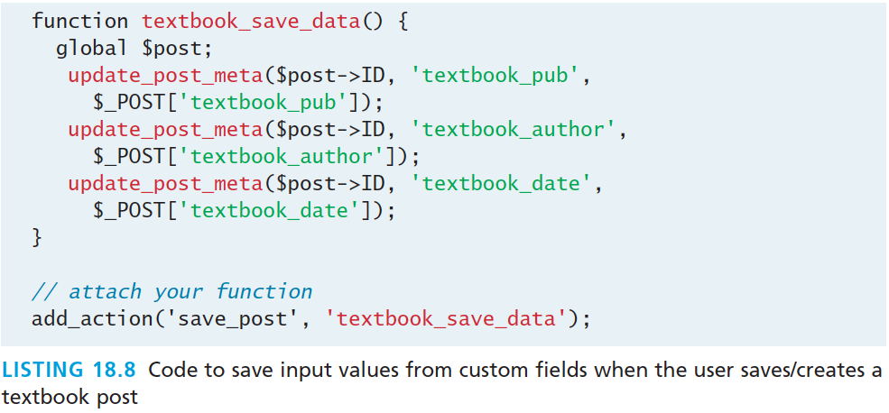
Under the Hood
Where do our posts go?

Slide 86
Displaying our post type
Display that data we just stored
You will be need to define at least two templates.
single-textbook.php and displays a single textbook, and
archive of all the posts matching the type served from the file archive-textbook.php.

Slide 87
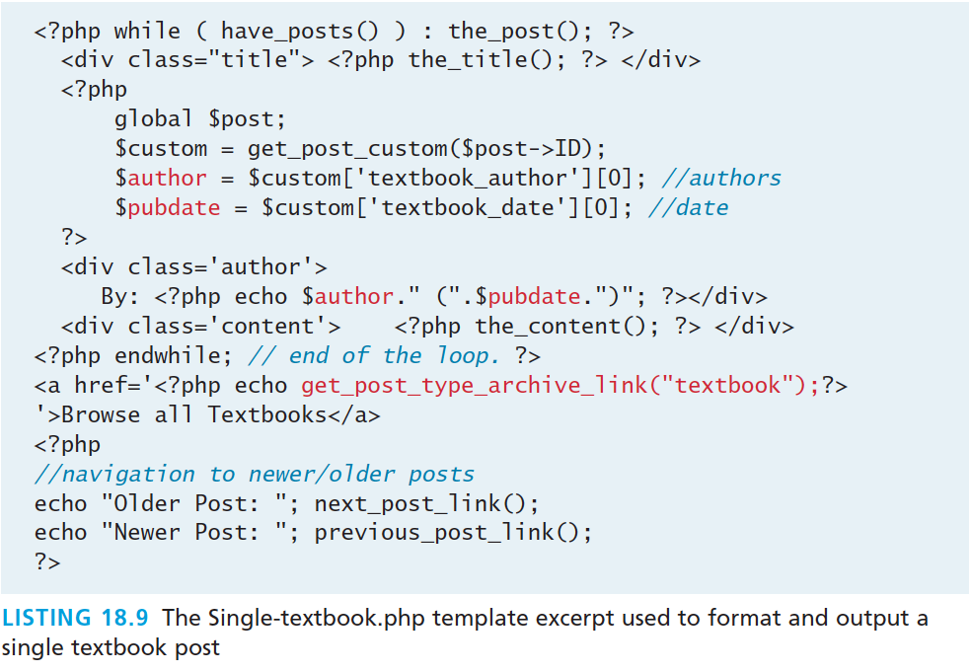
Single Post Template
Display that data we just stored

Slide 88
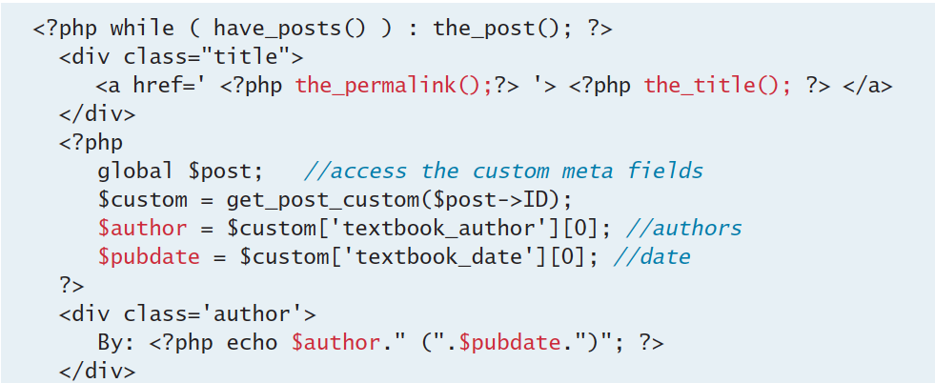
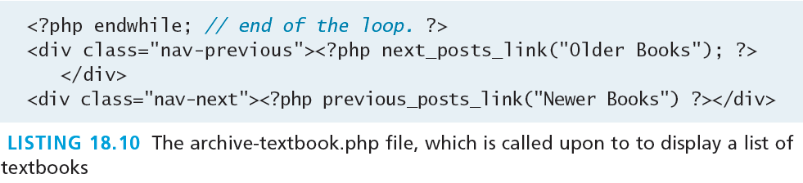
Archive Page Template
A List of posts

Slide 89
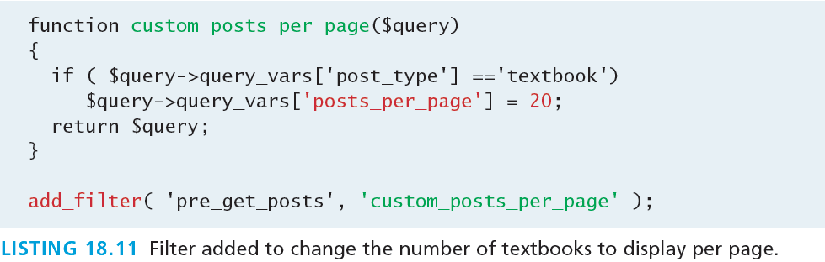
Tweaking result sets
Changing Pages Per Archive Page
One of the customizations you may want to make is to change how many posts are shown in an archive page. To accomplish that you have to add a filter to functions.php so that for our textbook post type the value is say 20 books, rather than the default.

Slide 90
Writing a Plugin
Section 8 of 8

Slide 91
Writing a Plugin
Getting Started
Plugins allow you to write code independent of the main WordPress framework and then use hooks, filters, and actions to link to the main code.
Much like themes, WordPress plugins reside in their own folder /wp-content/plugins/
Like themes, you should begin by creating a folder to contain all the files for your theme. Name the plugin folder something unique, which has not yet been used.

Slide 92
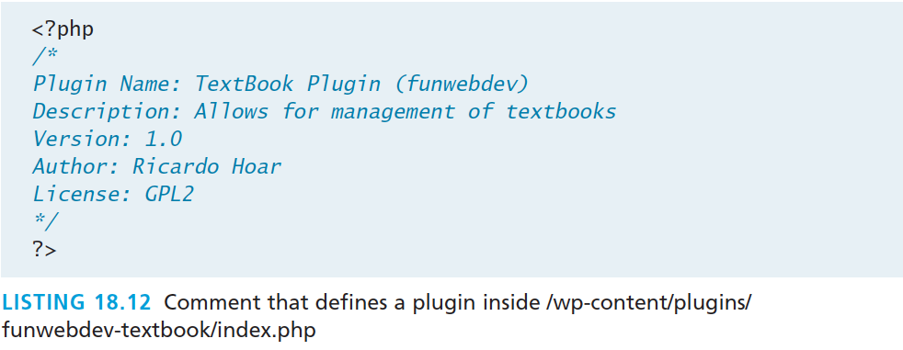
Writing a Plugin
Getting Started
Our first act is to create the main file for the plugin, index.php, inside our folder.

Slide 93
Hooks, Actions and Filters
Getting Started
Hooks are events that occur during the regular operation of WordPress.
Actions are PHP functions executed at specific times in the WordPress core.
Filters in WordPress allow you to choose a subset of data before doing something with it

Slide 94
Reuse some code from before
Convert Your Page Type Template to a Plugin
Take all the code we added to functions.php in the child theme and add it to our plugin’s index.php.
Recall this code defined the textbook page, and added code to properly display textbooks in the admin interface.

Slide 95
Activate Your Plugin
Finally something super easy.

Slide 96
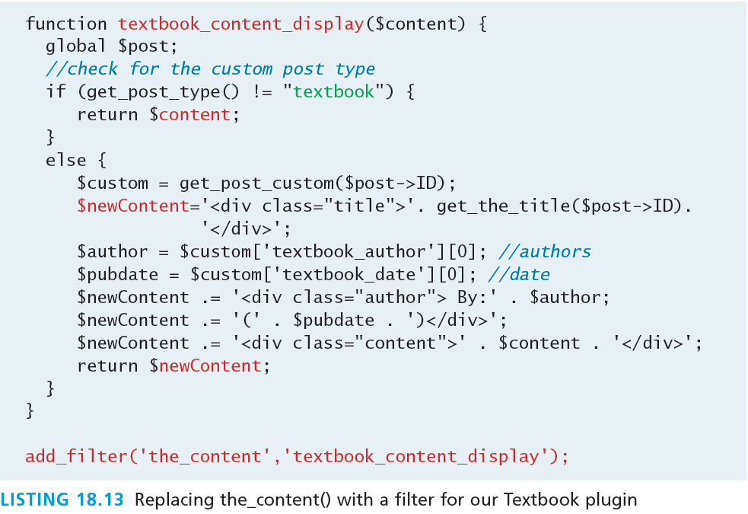
Output of the Plugin
To finish this plugin, you must move the code from the templates into the plugin file (index.php).

Slide 97
Make it a widget
Widget, Plugin, Template, oh my
To the user, widgets are easy-to-manage and customizable components they can add to the sidebar.
To create a widget that displays a random book, we therefore only have to define one function for displaying the content of the widget.

Slide 98
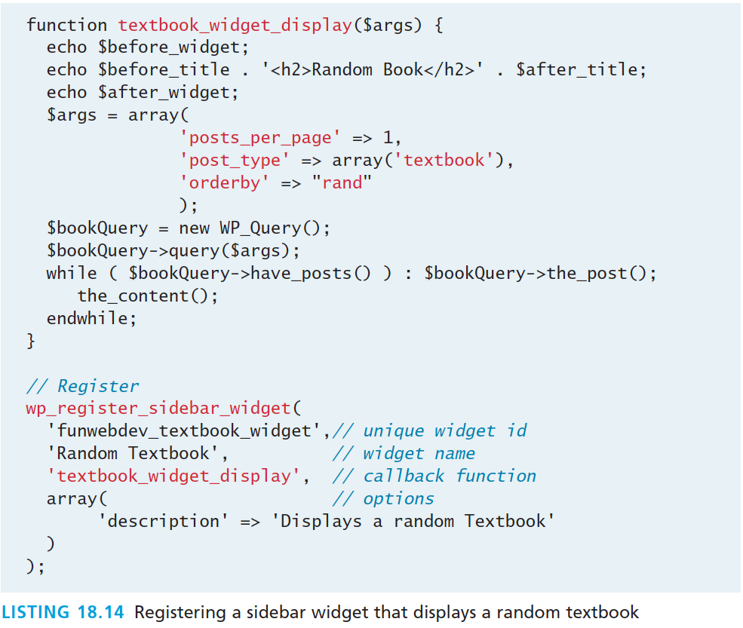
Make it a widget
Widget, Plugin, Template, oh my

Slide 99
What You’ve Learned
1
2
Content Management Systems (CMS)
Managing websites
3
4
CMS Components
WordPress Technical Overview
5
6
Customizing WordPress Templates
Modifying Themes
7
8
7
Creating a Custom Post Type
7
Writing a Plugin

